Slide 1
Qiime2 Overview
Anna K. Knight

Slide 2
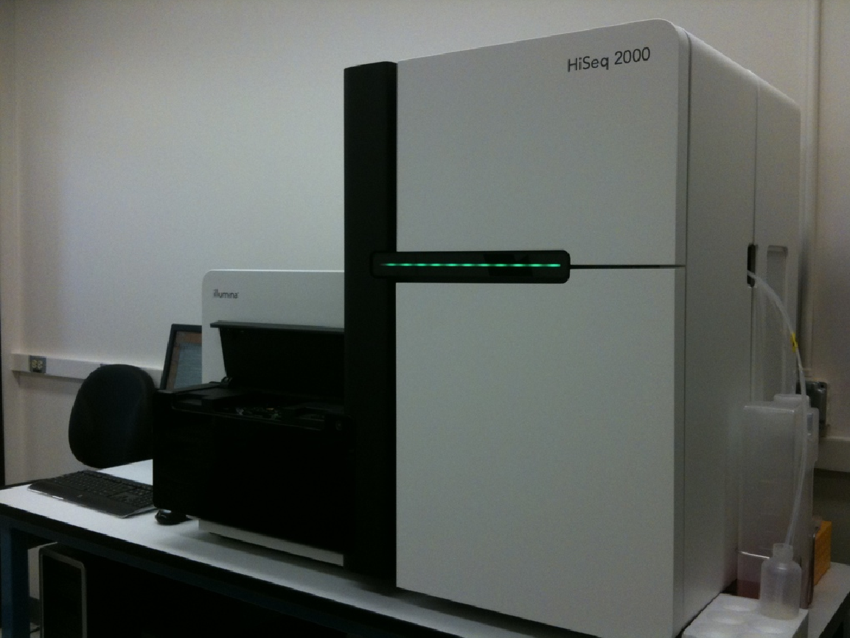

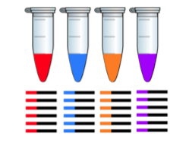
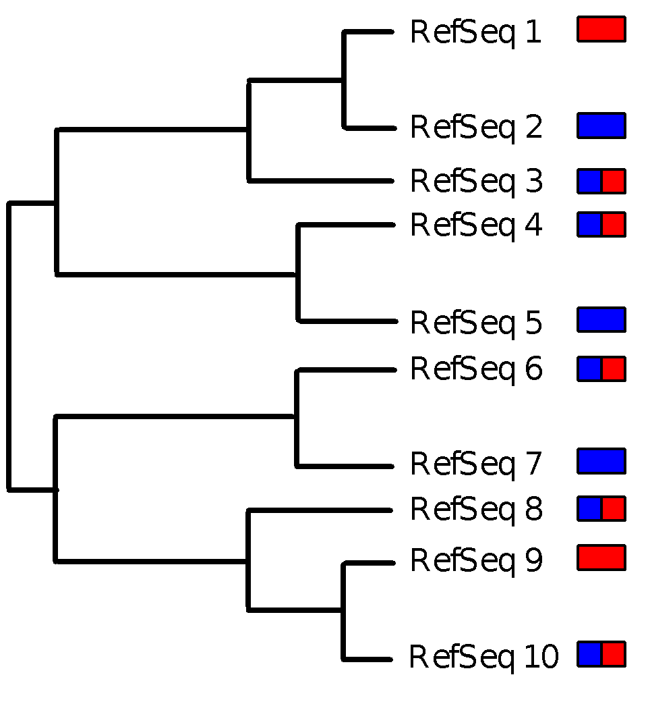
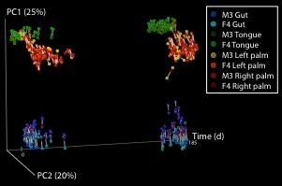
qiime2.org
>GCACCTGAGGACAGGCATGAGGAA…
>GCACCTGAGGACAGGGGAGGAGGA…
>TCACATGAACCTAGGCAGGACGAA…
>CTACCGGAGGACAGGCATGAGGAT…
>TCACATGAACCTAGGCAGGAGGAA…
>GCACCTGAGGACACGCAGGACGAC…
>CTACCGGAGGACAGGCAGGAGGAA…
>CTACCGGAGGACACACAGGAGGAA…
>GAACCTTCACATAGGCAGGAGGAT…
>TCACATGAACCTAGGGGCAAGGAA…
>GCACCTGAGGACAGGCAGGAGGAA…
Assign millions of sequences from thousands of samples to reference
Compare samples statistically and visually
Assign reads to samples
QIIME 2, https://qiime2.org

Slide 3
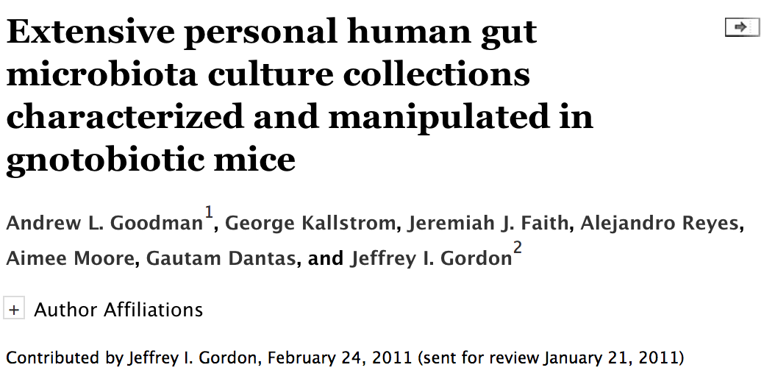
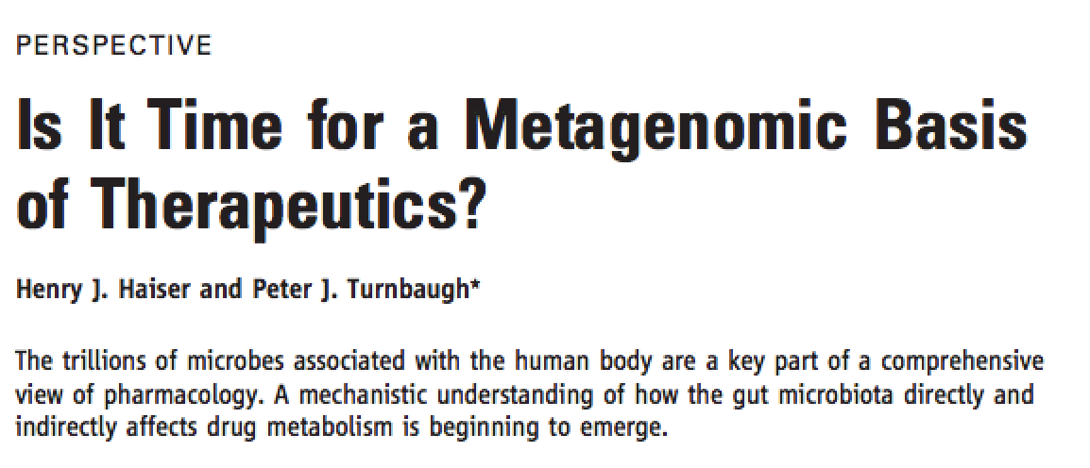
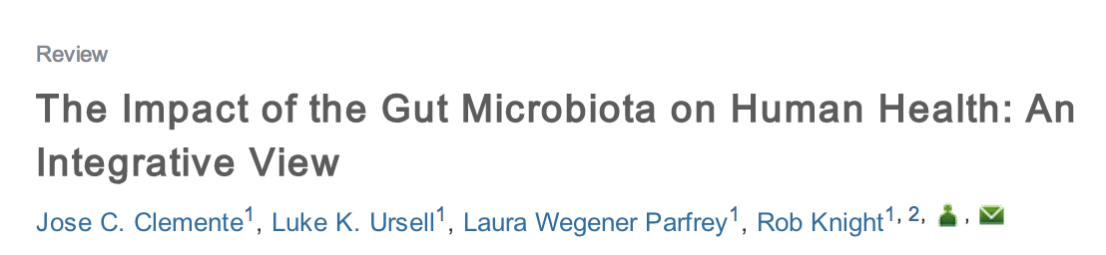
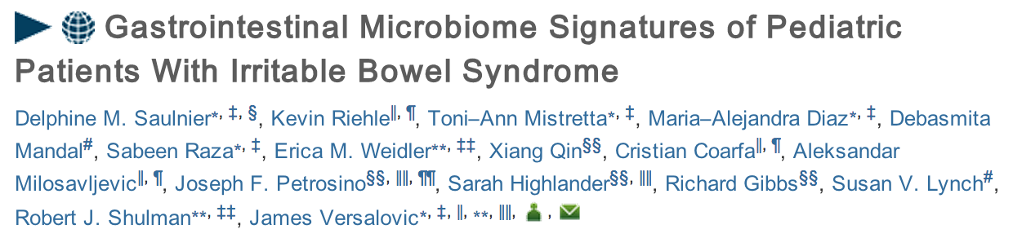
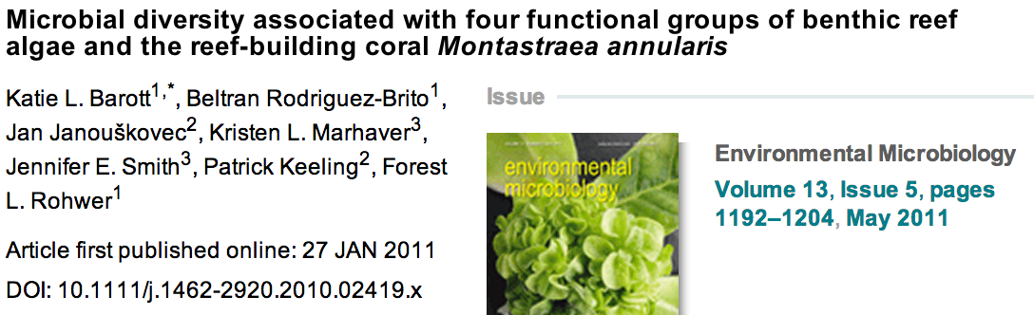
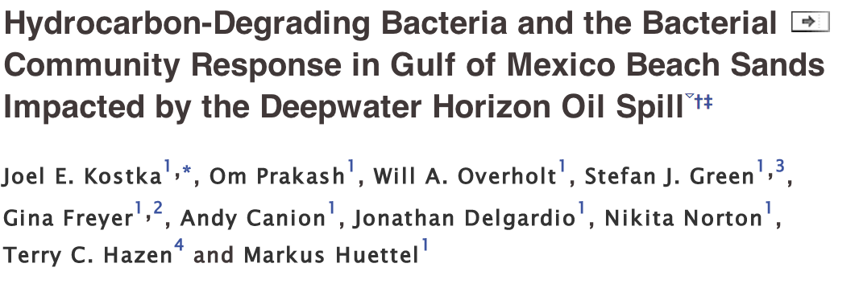

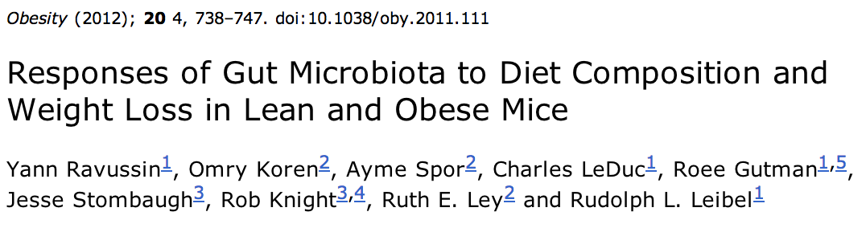
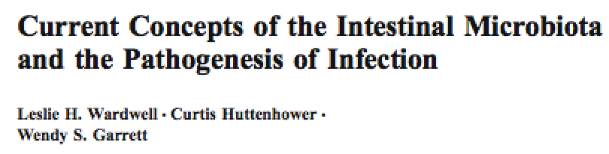
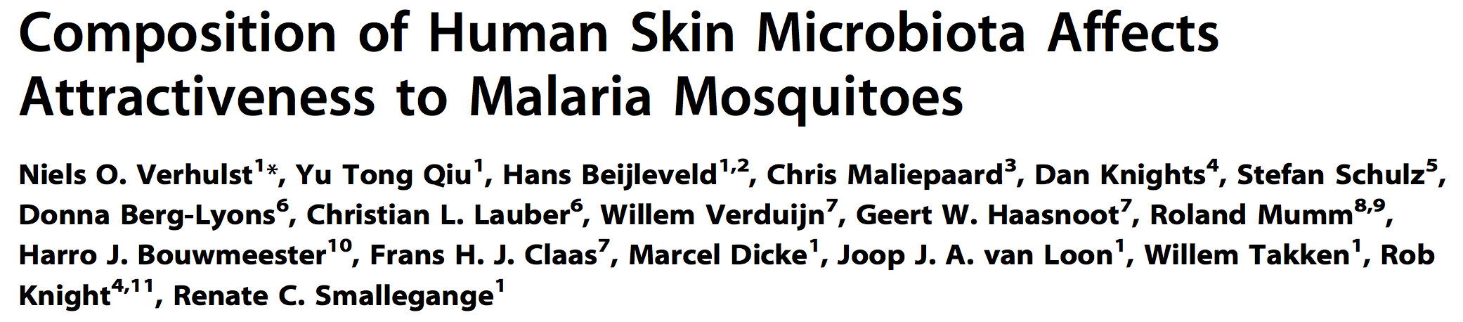

A few of the > 5600 articles citing QIIME
PNAS (2011)
Science (2012)
Cell (2012)
Gastroenterology (2011)
Applied and Environmental Microbiology (2011)
Current Infectious Disease Reports (2011)
PLoS One (2011)
Microbiology and Molecular Biology Reviews (2013)
QIIME 2, https://qiime2.org

Slide 4

QIIME 2 goals
Interface-agnostic: same analyses can be run from the command line, graphical interfaces, and as a component of systems such as Illumina BaseSpace.
Integrated “provenance tracking”: you can always trace back to understand exactly where your data files came from. Can also support automated methods text/diagram generation.
Decentralized development: a plugin system allows third-party developers to contribute analyses, which means users can get the latest methods as soon as possible.
Semantic type system: all data are of well-defined types, which enables interfaces to allow only analyses that make sense given the data, and to suggest possible analytic pathways.
QIIME 2, https://qiime2.org

Slide 5
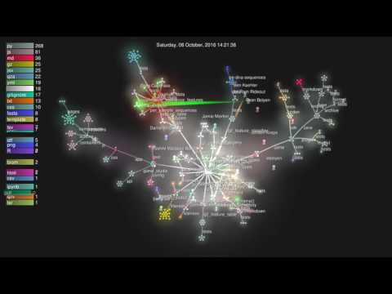
QIIME 2 development activity

Slide 6
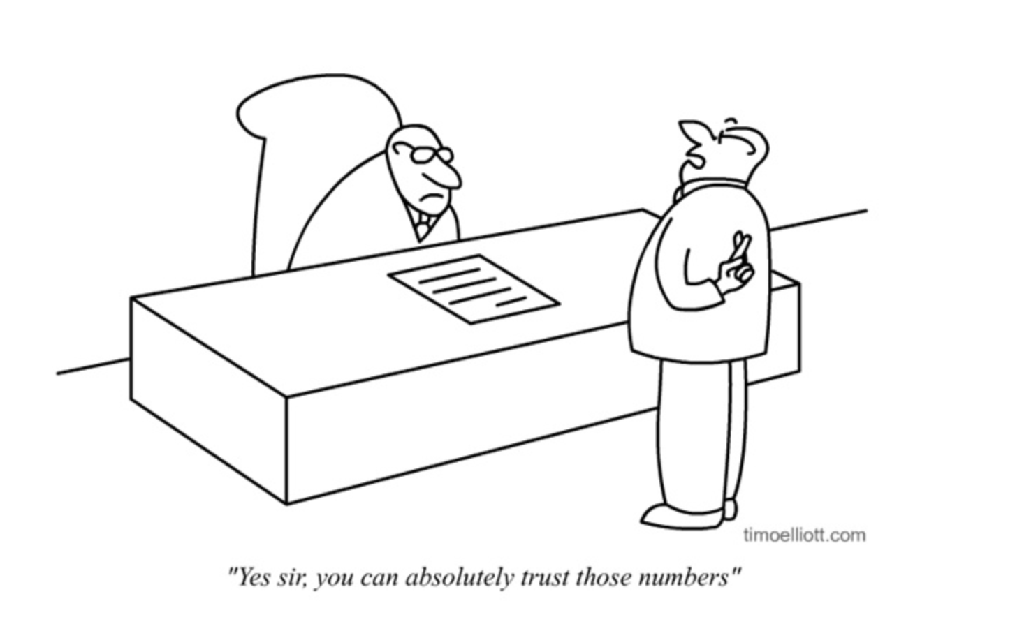

Slide 7
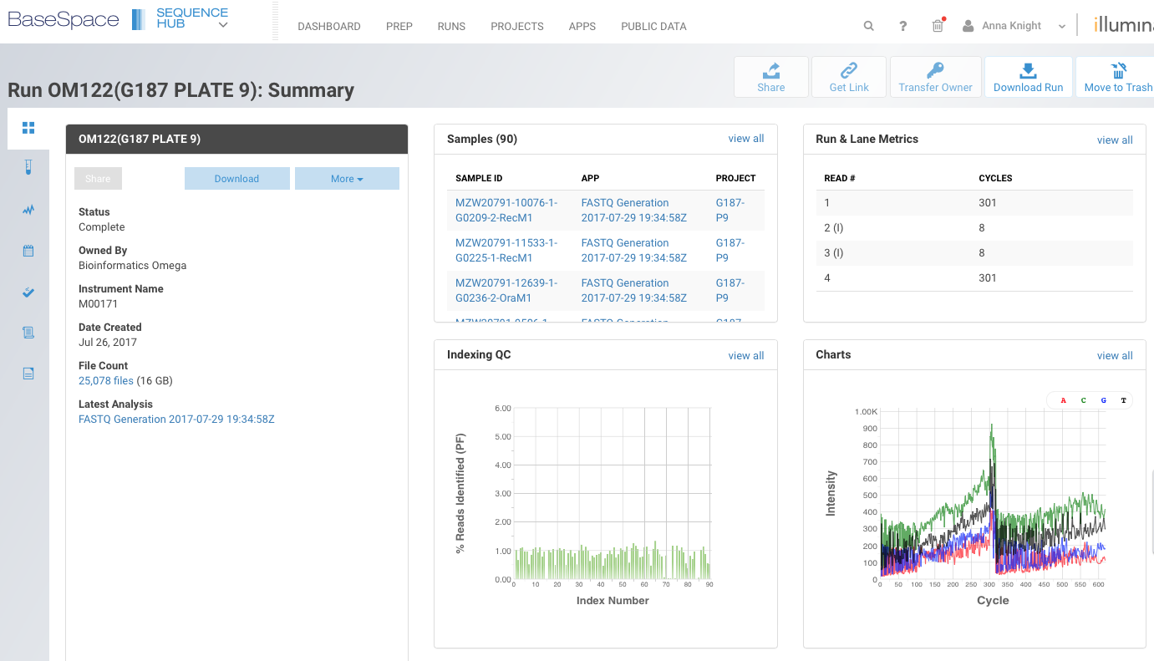
BaseSpace
BaseSpace is Illumina’s software for returning sequencing data, showing QC metrics, and interacting with their 16S app

Slide 8
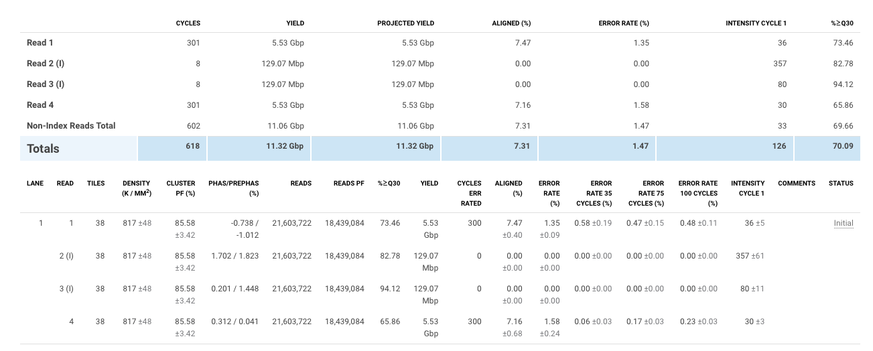
Illumina Sample Data
Cluster PF (pass filter)
85% pass chastity filter (ratio of the brightest base intensity divided by the sum of the brightest and second brightest base intensities. Clusters of reads pass the filter if no more than 1 base call has a chastity value below 0.6 in the first 25 cycles. This filtration process removes the least reliable clusters from the image analysis results)

Slide 9
Illumina Sample Data
>70% of reads have an average quality score >30

Slide 10
Illumina Sample Data
Cluster Density: Must be below 1400, but recommended 800-1000 for 16S because of low sequencing diversity

Slide 11
Illumina Sample Data
Phasing: the rate at which single molecules within a cluster get out of sync with one another
A value of .10/.10 means .10% of molecules in a cluster are falling behind and .10% are running ahead; ie, .20% of the true signal is lost each cycle and will contribute to noise.
Calculated to apply a phasing correction to the run so you don’t get random base calls
Recommend is between .1-.2, but must be <.25 and should never be 0.
http://lab.loman.net/high-throughput%20sequencing/2013/11/21/diagnosing-problems-with-phasing-and-pre-phasing-on-illumina-platforms/

Slide 12
What causes high/low phasing/prephasing?
Improper handling/storage of reagents
Machine not washed
Fluidics problem
Not enough PhiX

Slide 13
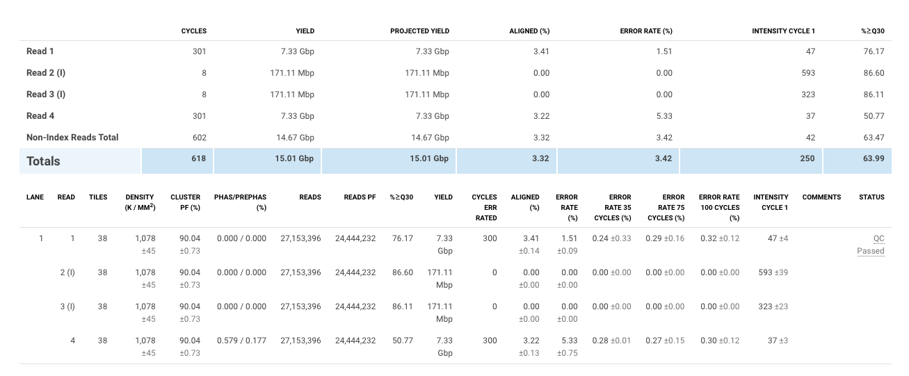
Example of a failed run
<5% PhiX
<70%
Good
Shouldn’t be 0; also >.25
Density a little high, but ok

Slide 14

Data Quality
Please check these metrics for each plate!!!
Failed runs give bad data!!
After you’ve checked these metrics, you’re ready for Qiime2

Slide 15

Qiime2 Core Concepts
Data produced by Qiime2 is called an artifact, which includes data and metadata for provenance tracking (more later…)
Artifacts have the extension .qza, visualizations are .qzv
You cannot open .qza or .qzv files on your local computer
They are essentially zipped archives
Qiime2 works via plugins- user-developed software packages that perform analyses of interest
OTU tables have become ASV tables

Slide 16
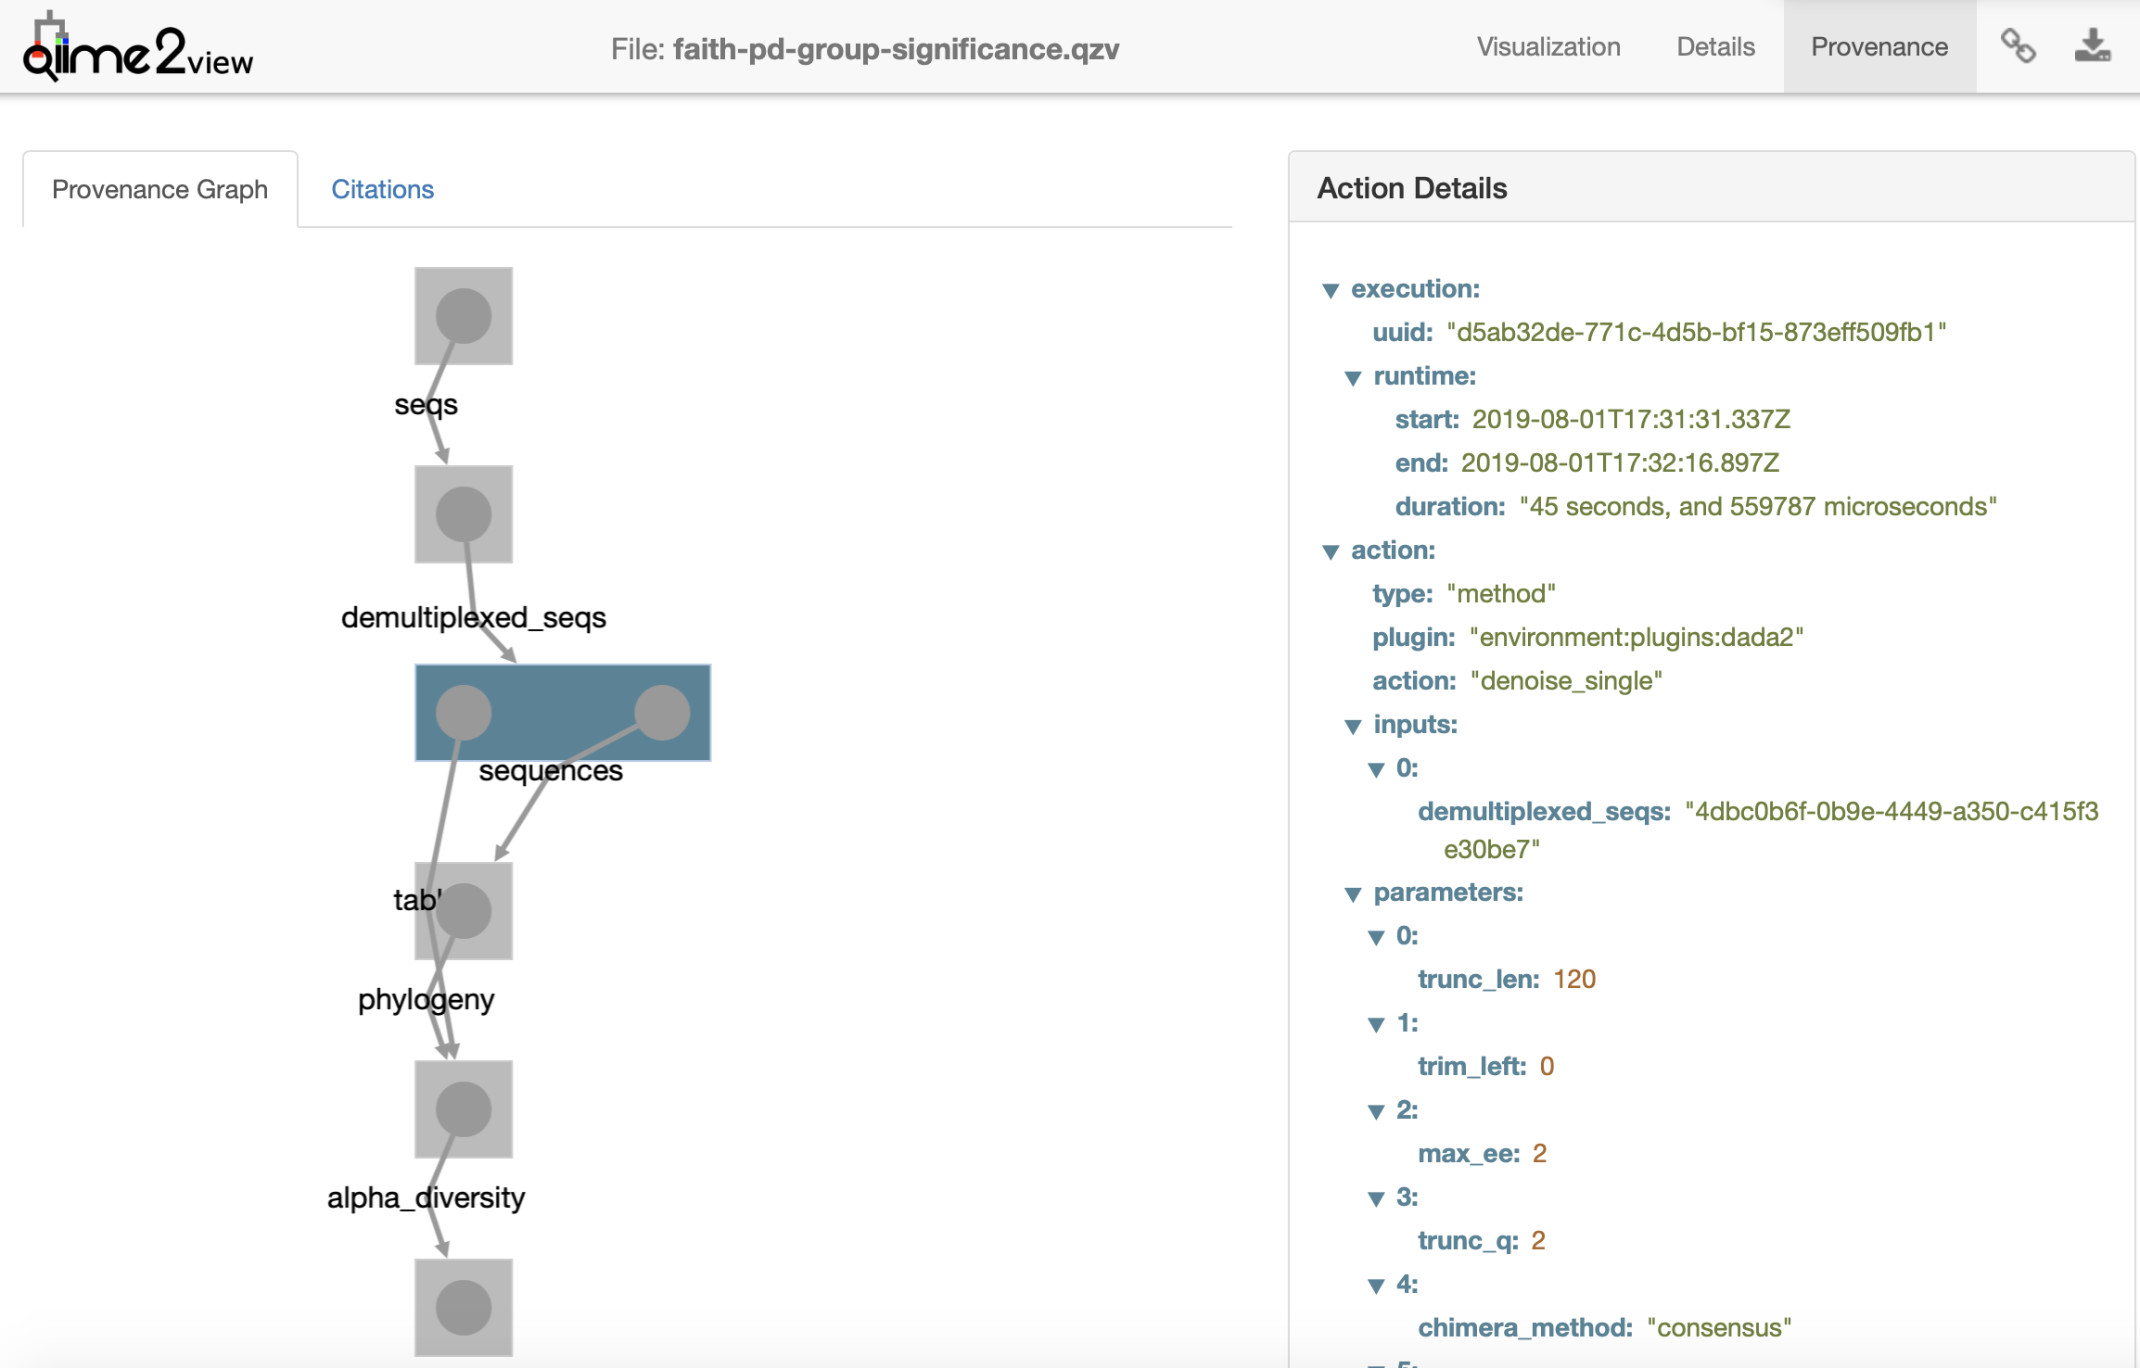
Provenance Tracking
Metadata in a Qiime2 .qza or .qvz file shows all of the steps of how it was created
Helps with replicability and reproducibility
View at https://view.qiime2.org

Slide 17
Installation
Instructions: https://docs.qiime2.org/2019.7/install/
Qiime2 installation is EASY, a huge improvement over Qiime
Can be installed locally or on a virtual machine
Windows is not supported and require a virtual machine
Install Miniconda (https://docs.conda.io/en/latest/miniconda.html)
Get Qiime2:
$ wget https://data.qiime2.org/distro/core/qiime2-2019.7-py36-linux-conda.yml
$ conda env create -n qiime2-2019.7 --file qiime2-2019.7-py36-linux-conda.yml
3. Activate the conda environment:
$ source activate qiime2-2019.7
I’ve done this for you on an AWS AMI

Slide 18
General Tips and Hints
Do you have a typo?
Check your dashes/ quotes- if you copy and paste, sometimes “--” becomes “—” or quotes (" ") change to smart quotes (“ ”)
Error: Verify the correct quotes or dashes (ASCII) are being used
Are you in the right directory?
Is your path correct?

Slide 19
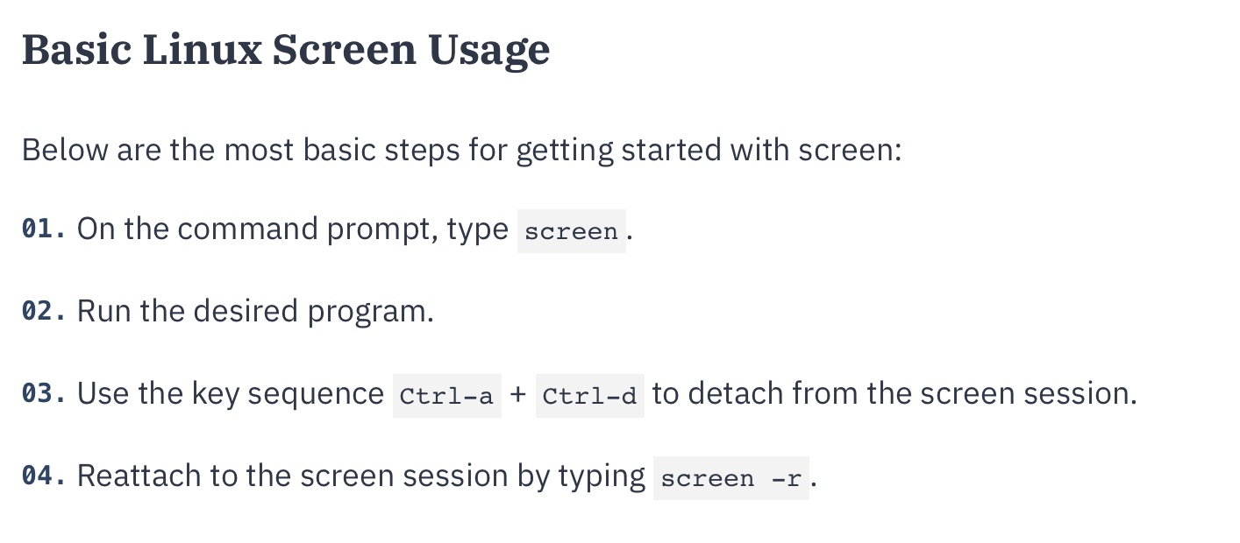
Using screen
Screen allows you to detach from long-running processes
Some Qiime2 commands run hours-days depending on the size of your dataset, and you don’t want to be subject to the whims of the wifi

Slide 20

Data Processing Steps
Importing raw sequence (FASTQ) data into QIIME 2
View stats
Sequence Quality Control & Feature Table
Check stats
Summarize Feature and Data tables
Make a phylogenetic tree
Calculate Diversity Scores
Phyloseq
QIIME 2, https://qiime2.org

Slide 21
Code Available:
https://annaknight.wixsite.com/mysite

Slide 22
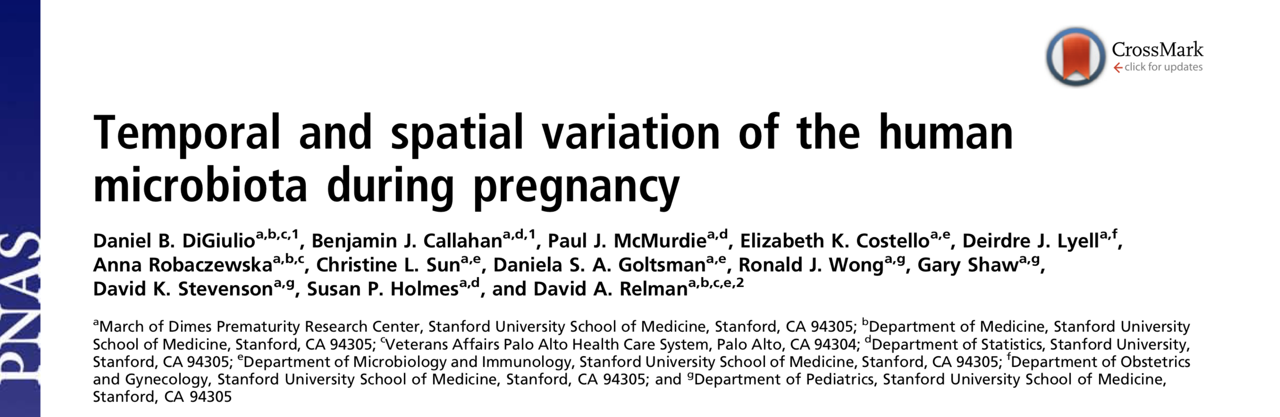

Slide 23
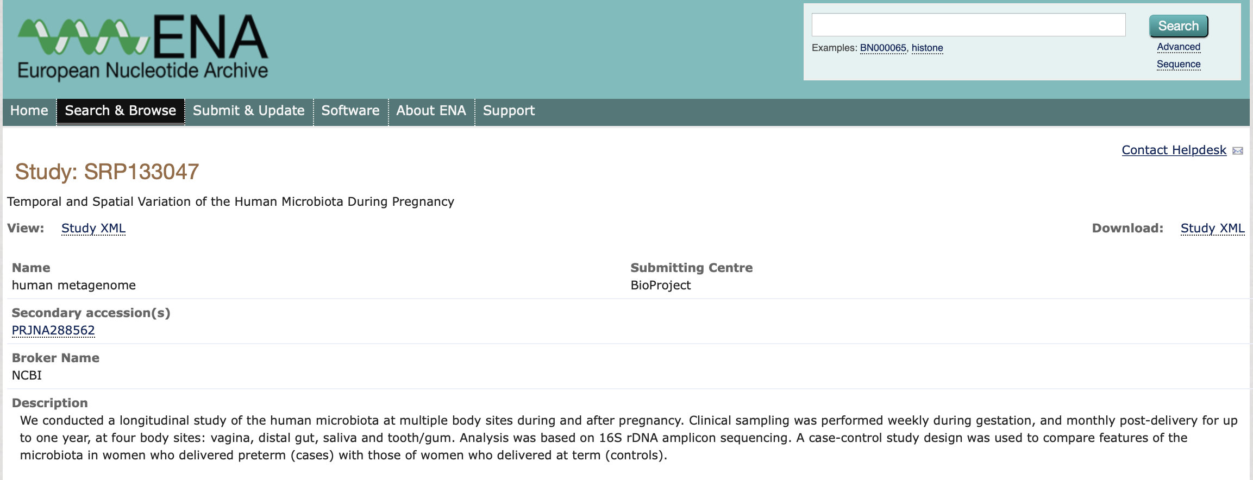

Slide 24
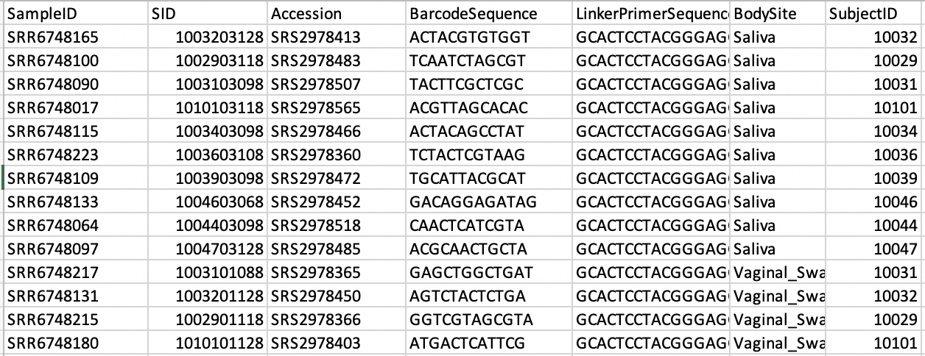
About the dataset
20 random samples (10 vaginal, 10 oral)
V3-V5
Available phenotype data includes:
Gestational age/ Preterm birth
Preeclampsia
Birthweight
Race
SES

Slide 25
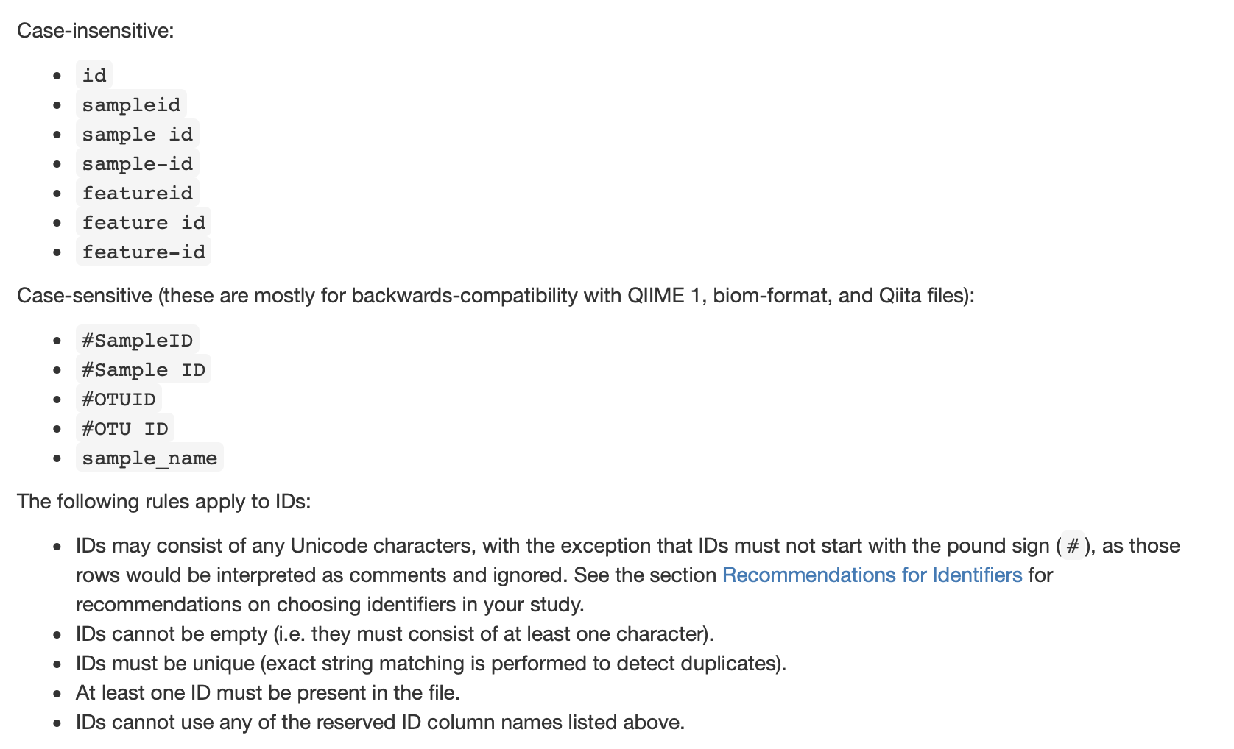
Metadata file
Qiime2 has a very specific metadata (map) file structure
Typically a .tsv or .txt file
The 1st column MUST be the sample id

Slide 26
Metadata File: Other notes
# lines will be ignored
Leading and trailing white spaces will be ignored
Identifiers should be 36 characters long or less.
Identifiers should contain only ASCII alphanumeric characters (i.e. in the range of [a-z], [A-Z], or [0-9]), the period (.) character, or the dash (-) character.

Slide 27
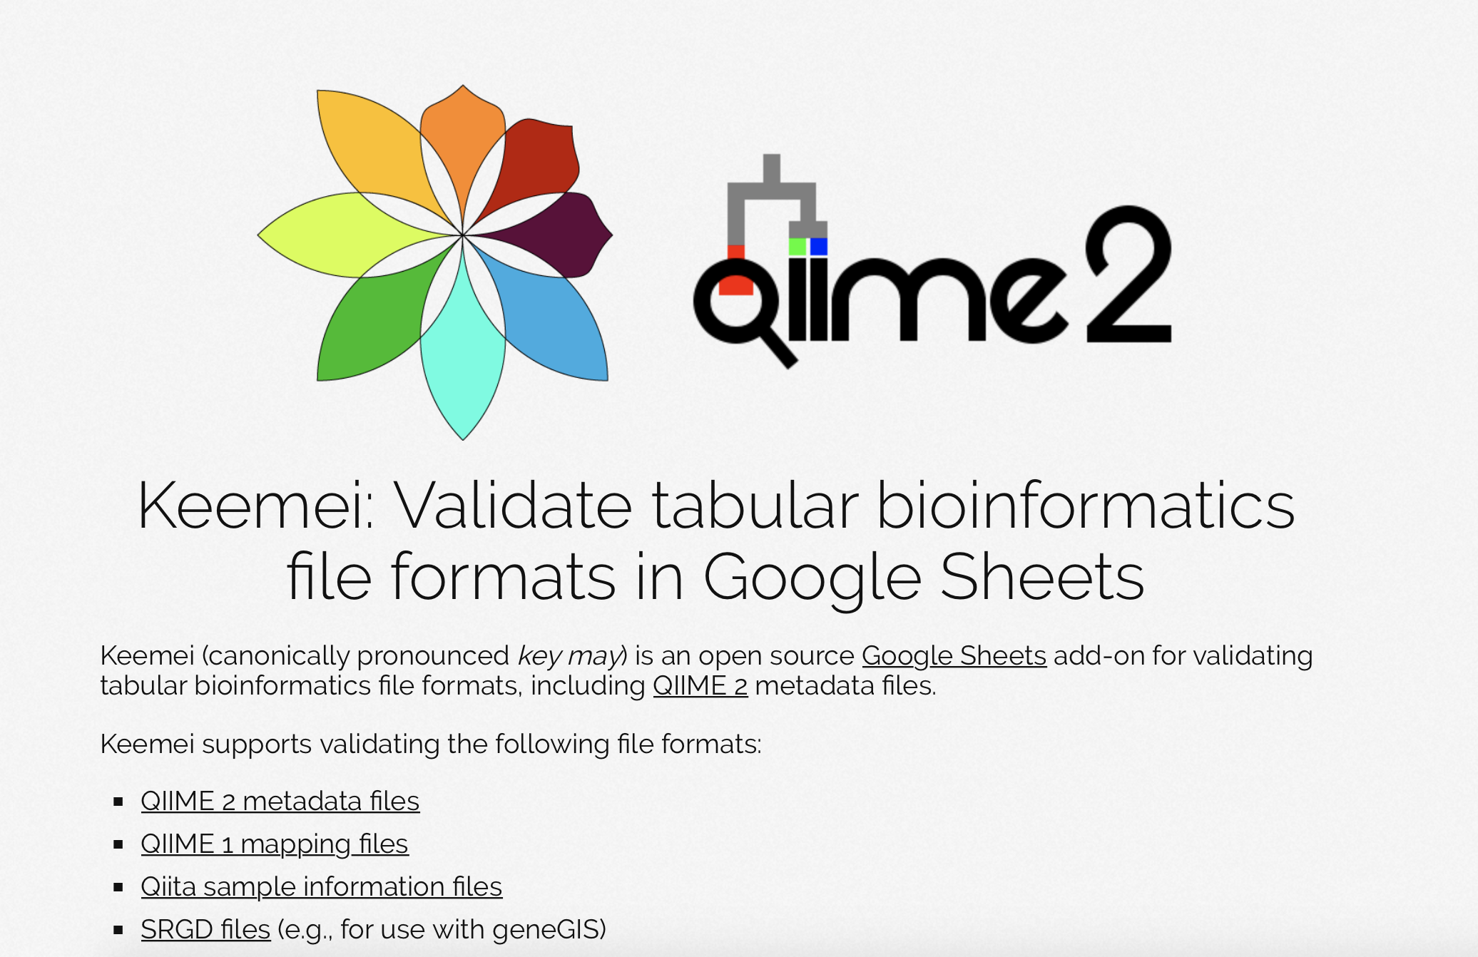
https://docs.google.com/spreadsheets/d/1AlOR_YPfAuZ1x3oDP-K60X6xIxyVoSjE55CRx2gJYsc/edit#gid=1072625227

Slide 28
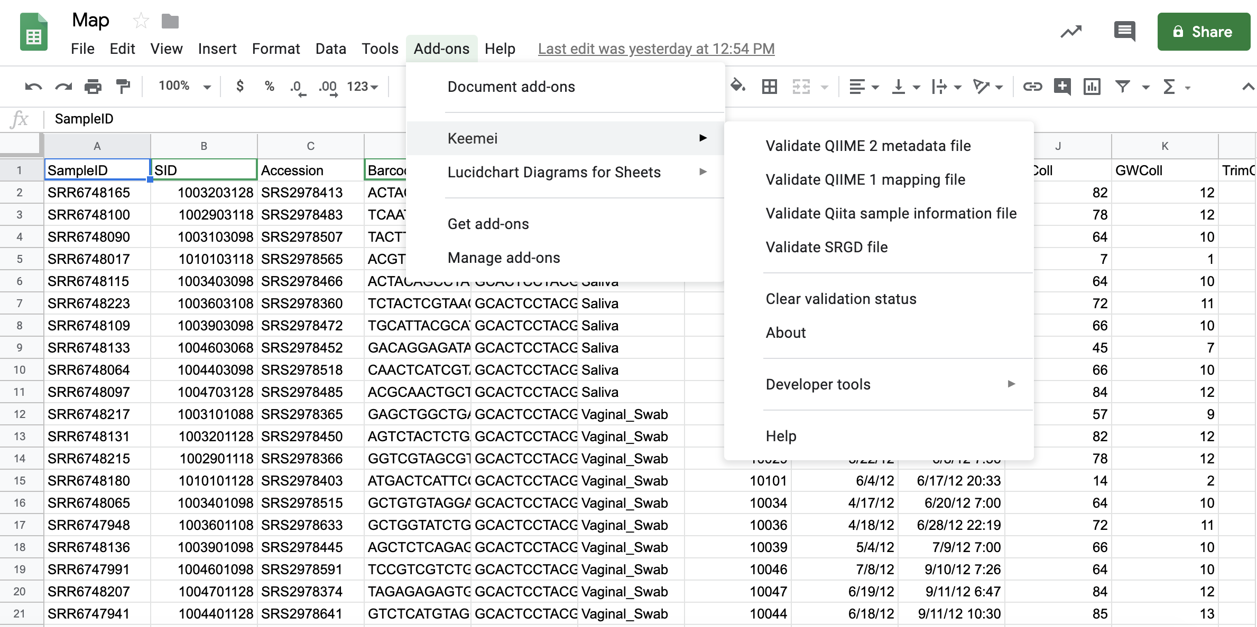
Keemai (key-may)
https://docs.google.com/spreadsheets/d/1AlOR_YPfAuZ1x3oDP-K60X6xIxyVoSjE55CRx2gJYsc/edit#gid=1072625227

Slide 29
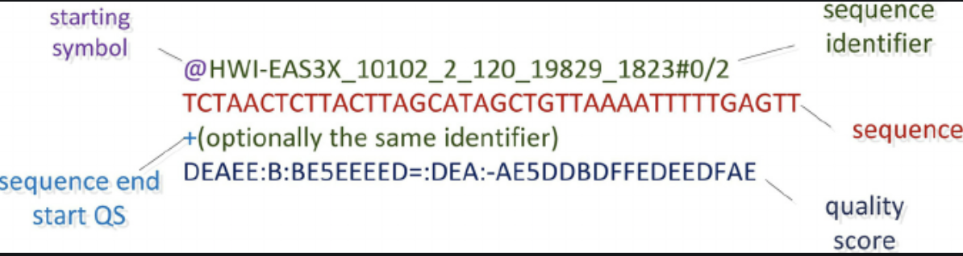
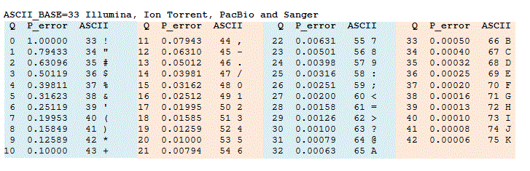
1. Importing FASTQ data into QIIME 2

Slide 30
1. Importing FASTQ data into QIIME 2
EIGC will return a forward and reverse fastq file for each sample
Files are demultiplexed on the MiSeq/HiSeq instrument, so you don’t have to do that step later
Single and paired end files have different commands- we’ll use paired end

Slide 31
1. Importing FASTQ data into QIIME 2
Log back onto your EC2 instance
Change directories into “ForAWS”:
cd ForAWS
Look at what’s there:
ls
Activate the Qiime2 environment:
source activate qiime2-2019.7
Import to Qiime2 (~3 minutes)
qiime tools import --type SampleData[PairedEndSequencesWithQuality] --input-path Manifest.csv --output-path paired-end.qza —input-format PairedEndFastqManifestPhred33
If you have a different input type, you can see the other options using:
qiime tools import --help

Slide 32
2. View stats
Look at the import stats
qiime demux summarize --i-data paired-end.qza --o-visualization paired-end.qzv
.qzv files cannot be viewed on EC2, we’ll download it to our local machine and use view.qiime2

Slide 33
Secure Copy Protocol (SCP)
We’ll use this to transfer files to and from our EC2 instance
General format:
To EC2:
scp -i “YourKey.pem” directory/file_to_transfer.csv ec2-user@ec2-54-88-177-232.compute-1.amazonaws.com:/home/ec2-user/ForAWS/
From EC2:
scp -i “YourKey.pem” ec2-user@ec2-54-88-177-232.compute-1.amazonaws.com:/home/ec2-user/ForAWS/file_to_transfer.csv directory/

Slide 34
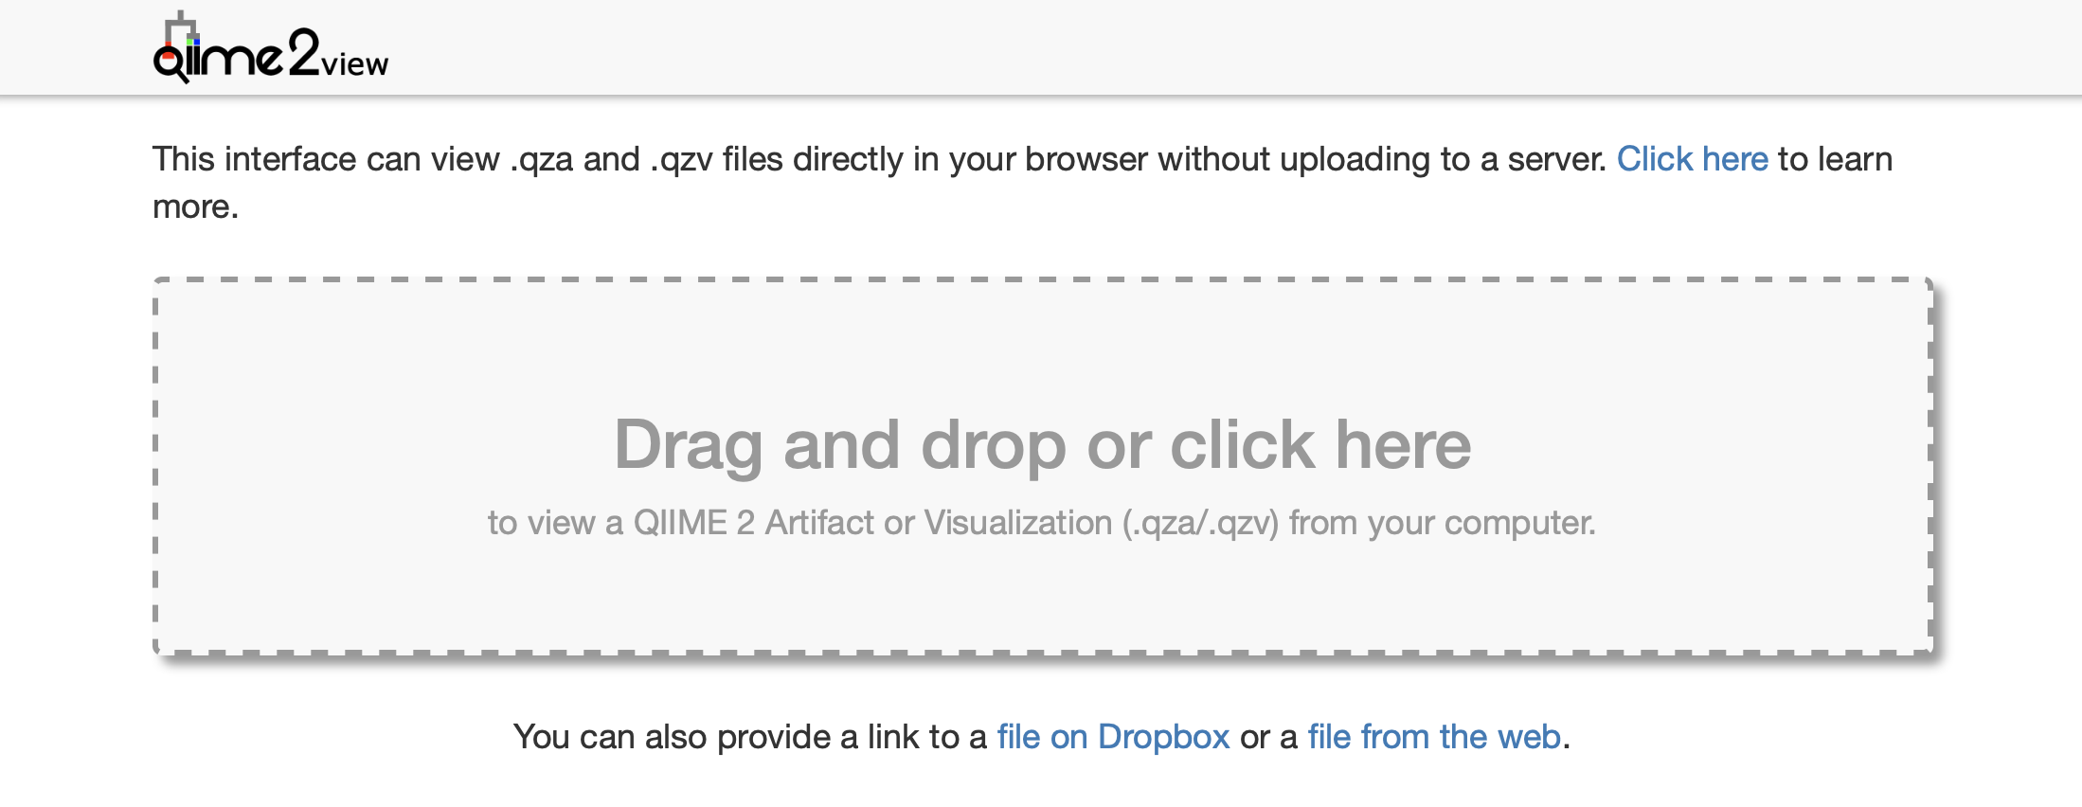
Qiime2 View
.qzv files can’t be viewed locally either…
Go to view.qiime2.org and upload your file

Slide 35
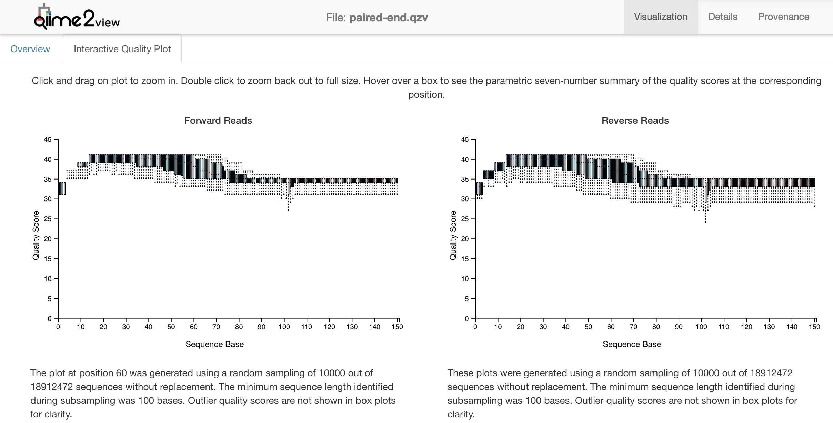
Use the quality scores to select cutoffs

Slide 36
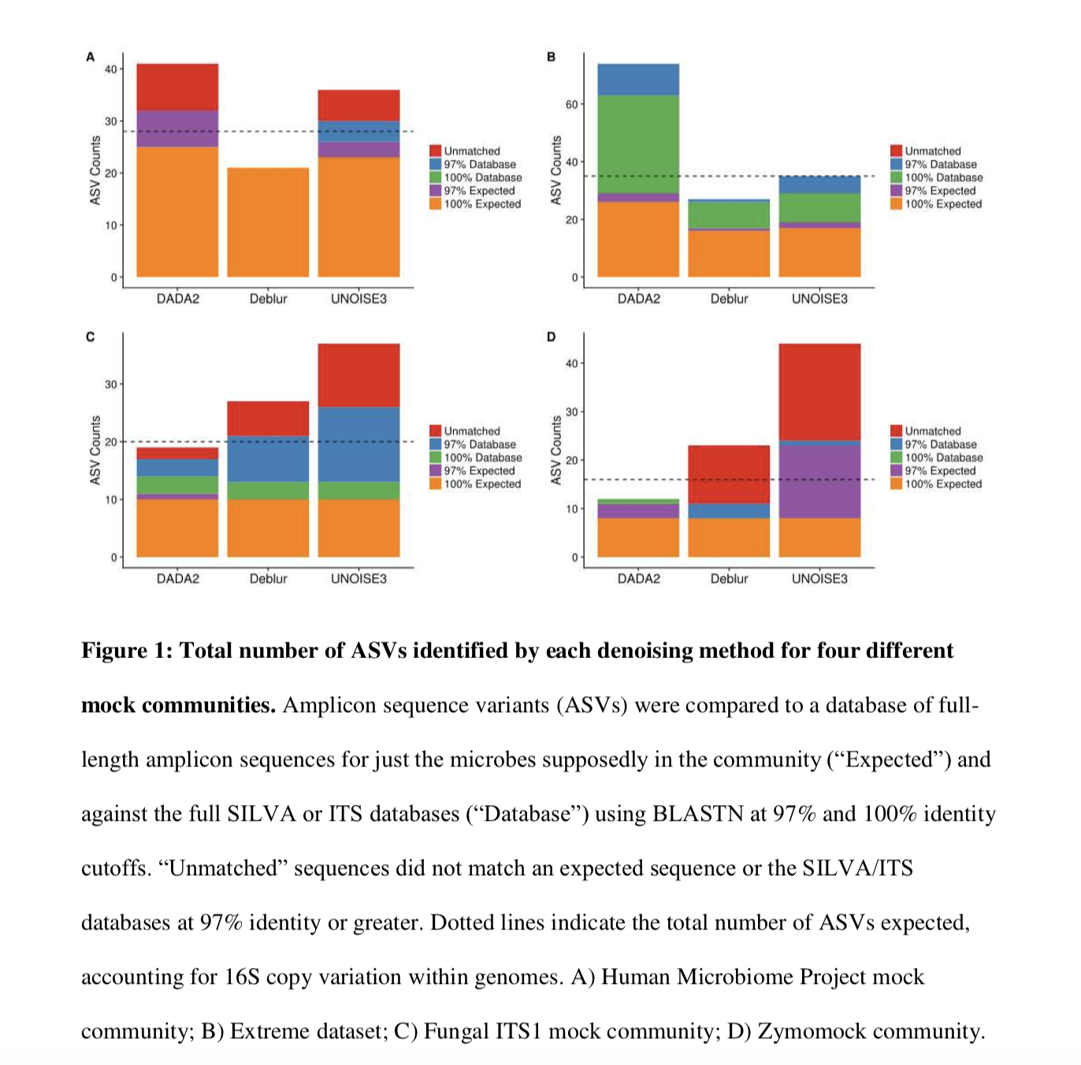
3. Sequence Quality Control & Feature Table
2 options available: DADA2 and Deblur
DADA2: learns an error model from the data, by alternating estimation of the error rates and inference of sample composition until they converge on a jointly consistent solution (Callahan)
Deblur: uses known error profiles to obtain putative error-free sequences from Illumina MiSeq and HiSeq sequencing platforms( Amir)
Neering, PeerJ, 2018

Slide 37
DADA2
Filter and Trim
Learn error rates- different for each plate
Identify unique sequences
Merge paired reads
Construct sequence table
https://benjjneb.github.io/dada2/tutorial.html

Slide 38
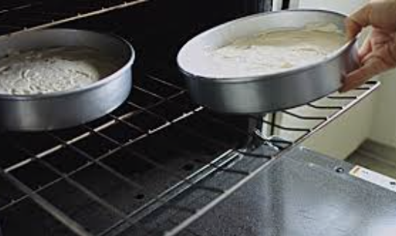
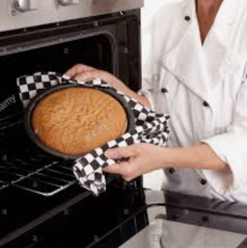
3. Sequence Quality Control & Feature Table
qiime dada2 denoise-paired --i-demultiplexed-seqs paired-end-demux.qza --o-table table.qza --o-representative-sequences rep-seqs.qza --p-trim-left-f 8 --p-trim-left-r 9 --p-trunc-len-f 150 --p-trunc-len-r 150 --p-n-threads 0 --o-denoising-stats denoisingstats.qza
~3 days

Slide 39
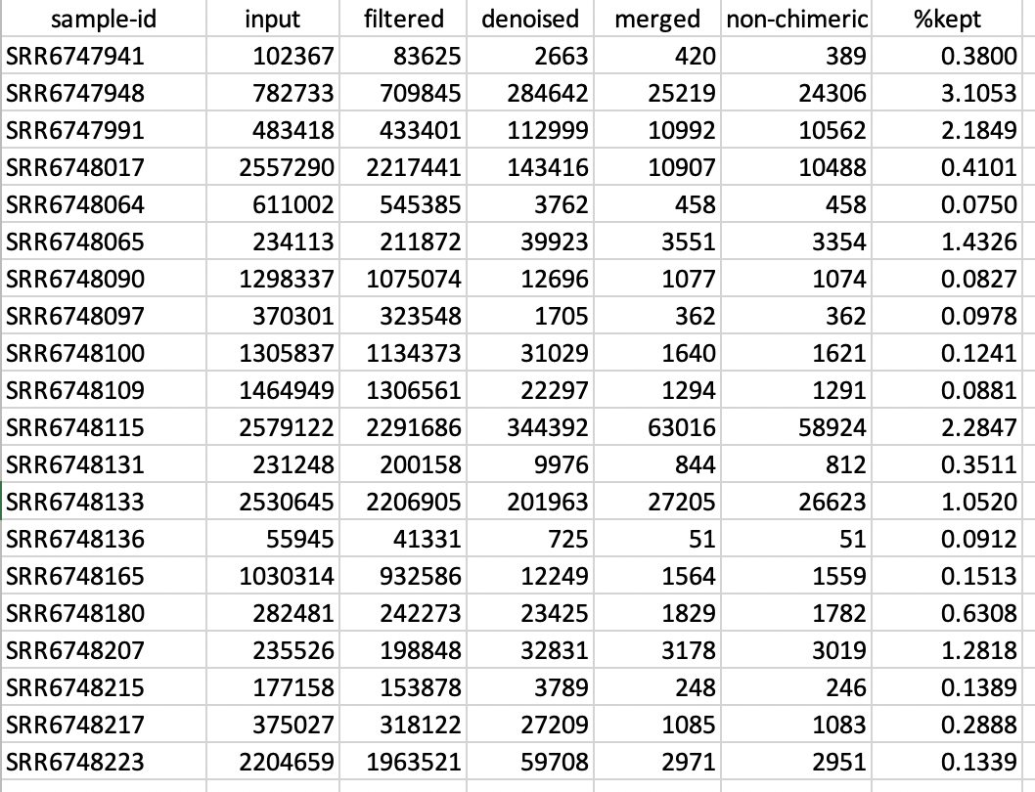
4. Check stats
qiime metadata tabulate --m-input-file denoisingstats.qza --o-visualization stats-dada2.qzv

Slide 40
5. Summarize Feature and Data tables
qiime feature-table summarize --i-table table.qza --o-visualization table.qzv --m-sample-metadata-file Map.tsv
qiime feature-table tabulate-seqs --i-data rep-seqs.qza --o-visualization rep-seqs.qzv

Slide 41
6. Assign Taxonomy & Make Barplot
qiime feature-classifier classify-sklearn --i-classifier classifier.qza --i-reads rep-seqs.qza --o-classification taxonomyV3V5.qza --p-n-jobs -1 --p-confidence .8
qiime taxa barplot --i-table table.qza --i-taxonomy taxonomyV3V5.qza --m-metadata-file Map.tsv --o-visualization taxa-bar-plotsV3V5.qzv

Slide 42
An aside- training a classifier
QIIME2’s built in classifier is for V4
EIGC uses V3-V4
Our dataset uses V3V5
There are detailed instructions for training other classifiers

Slide 43
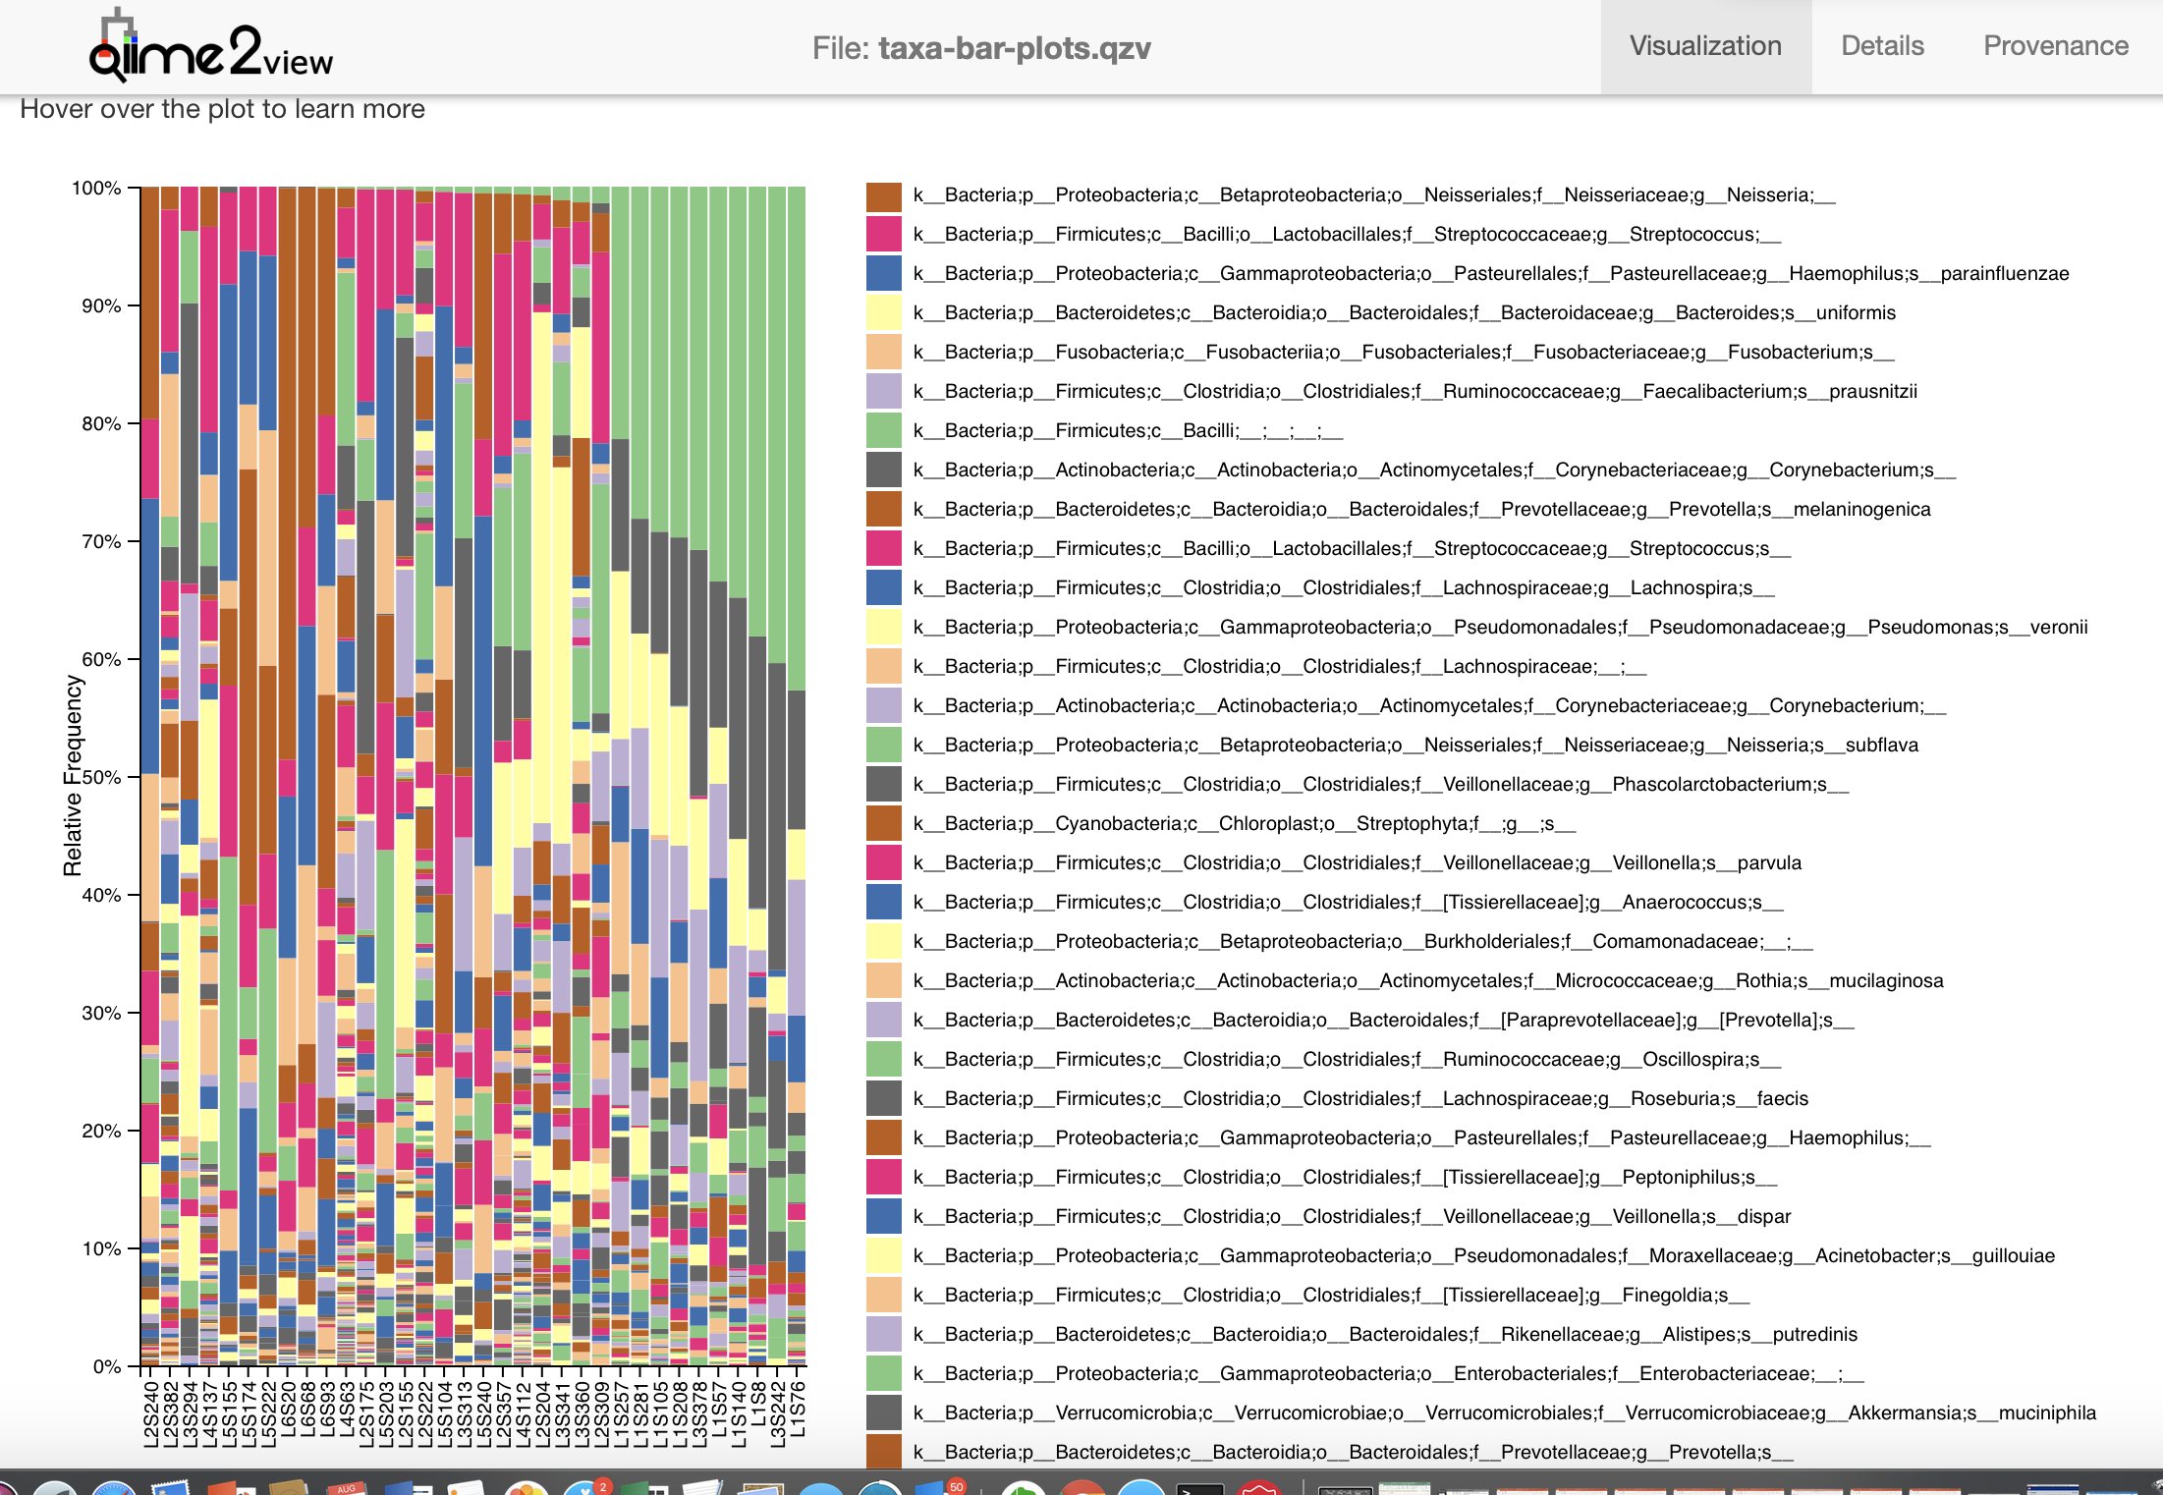

Slide 44
6. Make a phylogenetic tree
qiime phylogeny align-to-tree-mafft-fasttree --i-sequences rep-seqs.qza --o-alignment aligned-rep-seqs.qza --o-masked-alignment masked-aligned-rep-seqs.qza --o-tree unrooted-tree.qza --o-rooted-tree rooted-tree.qza
(not all diversity scores require a tree)
>5 hours

Slide 45
7. Calculate Diversity Scores
qiime diversity core-metrics-phylogenetic --i-phylogeny rooted-tree.qza --i-table table.qza --p-sampling-depth 723 --m-metadata-file Map.tsv --output-dir core-metrics-results
This can also be done outside of Qiime2

Slide 46
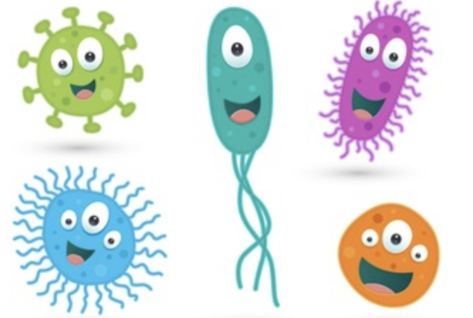
Studying the Microbiome
Diversity of the microbiome is a summary statistic that tells us about the overall environment
Richness: How many species are present?
Evenness: How are they distributed?
High Richness
Low Richness
Low Evenness
High Evenness

Slide 47
Alpha diversity metrics operate on a single sample (i.e., within sample diversity).
Beta diversity metrics operate on a pair of samples (i.e., between sample diversity). Phylogenetic diversity metrics incorporate evolutionary relationships between taxa, but assume that we know what those relationships are. Non-phylogenetic diversity metrics assume that all taxa are equally related, so don’t make assumptions about evolutionary relationships.
QIIME 2, https://qiime2.org

Slide 48
Use View to look at core diversity results!

Slide 49
Alpha Group Significance
qiime diversity alpha-group-significance --i-alpha-diversity ./core-metrics-results/evenness_vector.qza --m-metadata-file ./Map.tsv --o-visualization ./core-metrics-results/evenness_statistics.qzv
This can also be done outside of Qiime2

Slide 50
8. Exporting Data
qiime tools export --input-path table.qza --output-path exported
biom convert –i feature-table.biom -o table.tsv --to-tsv

Slide 51

https://joey711.github.io/phyloseq/index.html

Slide 52
